Slide 1
CSCI599: Life Simulator
Team: ZLX
Zhihan Zhang
Chuanzhe Li
Jia Xu

Slide 2
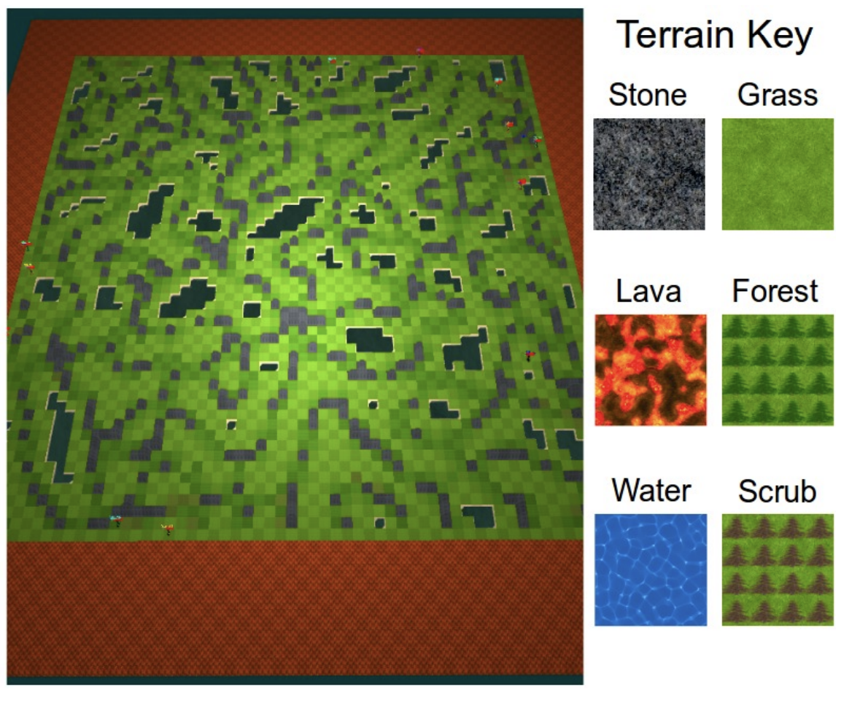

Introduction
Genre: Neural Massively Multiplayer Online Role-Playing Games (MMO)
Character: AI agents
Purpose: simulate the evolution of a large number of players competing to maximize survival time in a resource-limited environment
Map terrain:
Stone: inaccessible
Grass & Scrub: traversable
Lava: die once enter
Forest: traversable, get 5 points food, resource has 2.5% to regenerate
Water: inaccessible, can get water near it

Slide 3
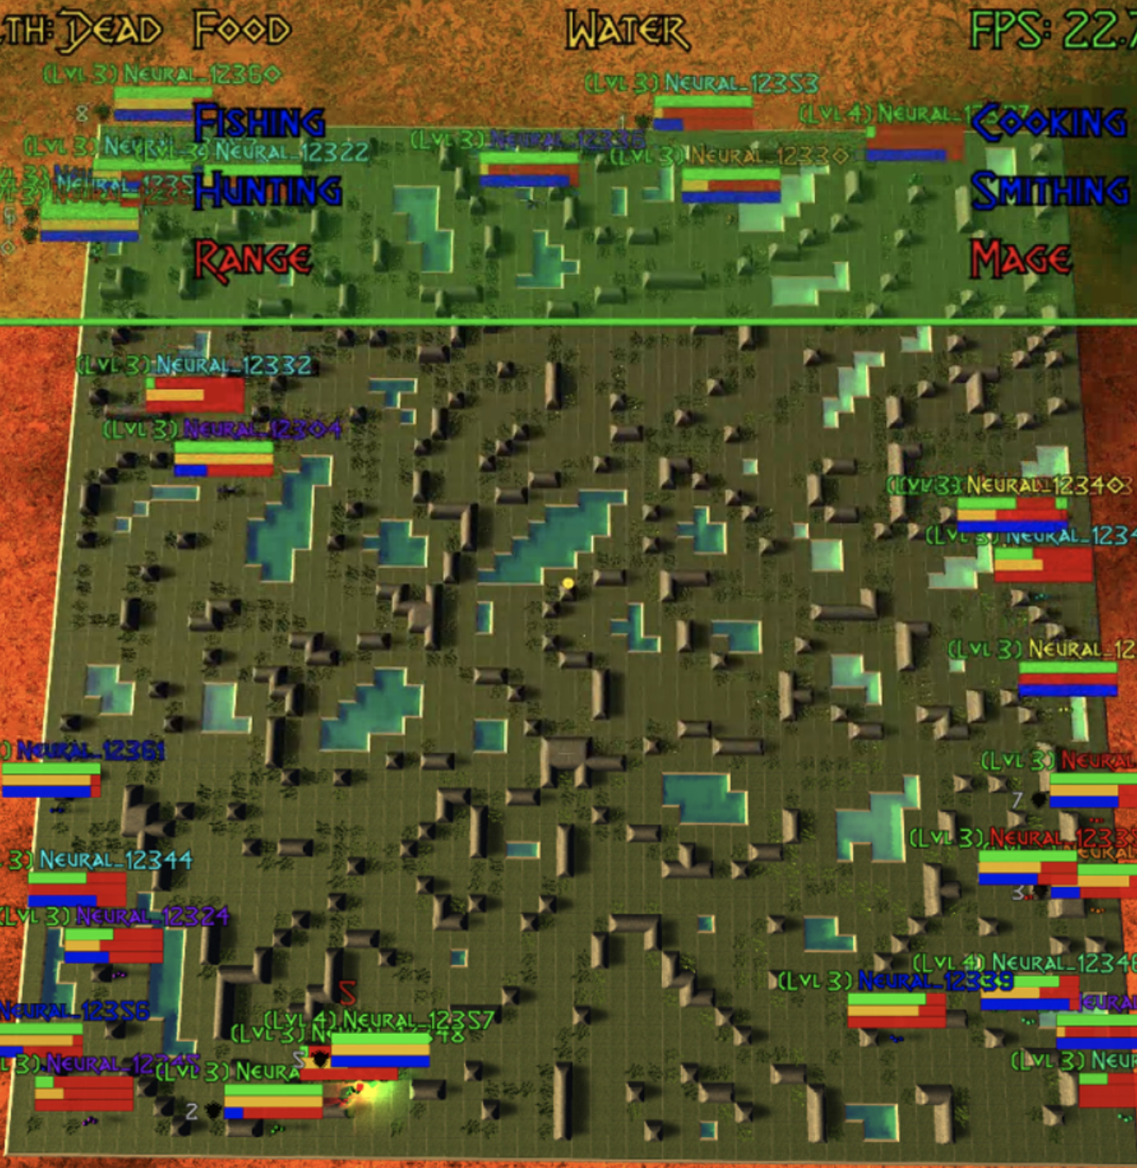
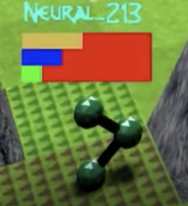
Introduction
Food
Water
Health
AI agent

Slide 4
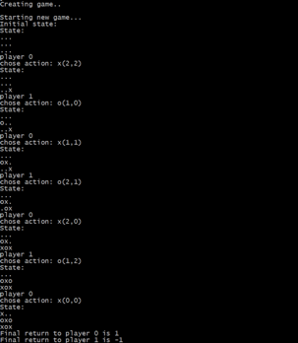
Project Ideas- Stage1
Explored classic algorithms : model-based learning
eg. Monte Carlo Tree Search
Game Application: tic-tac-toe
Research Result:
work for small amount of agents and need less generalization
not applicable for our goal because the performance is bad in scale

Slide 5
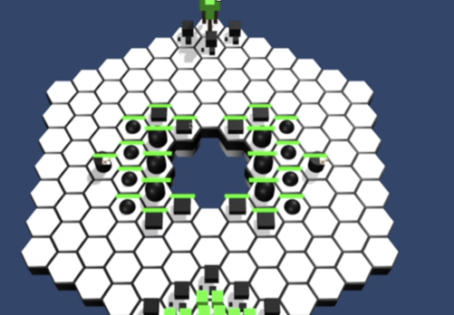
Project Ideas- Stage2
Explored: 1. turn-based strategy board game
2. Machine Learning-Agent
Research Result:
benefited a lot
but found problem that turn-based game needs an on-demand decision making process which is still under development in Unity

Slide 6
Project Ideas- why Deep Reinforcement Learning
Traditional Reinforcement Learning : needs to design complex rules for each agents to maximize their rewards during gaming play
Not make sense: intelligence made by beings come from learning.
like walking or sitting come in nature, everybody can do it.
But something people can just learn from practice such as driving or dance.
Inspiration：We can learn a huge variety of things even very complex one such as Go game or StarCraft II
many contemporary works made by Google or DeepMind which train their agents to achieve high degree of proficiency in domain governed by simple known rules such as The Game of Go

Slide 7
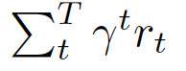
Project Ideas – Define terms in our model
s_{t} : the current state of given agents given time tick t, state contains position information, current food, water, health etc.
o_{t} : the current observation based on one agent.
a_{t} : the action made by given agent which have five types, North, West, East, South, Pass
∏ _{θ}(a_{t}|s_{t}): Policy(fully observed)
τ: the trajectory of given agents which is a sequence of observation, action and reward. τ = ( o_{t}, a_{t}, r_{t}, …, o_{T}, a_{T}, r_{T} )
R(τ): reward given trajectory which is the sum of each survival one in every time titch with discount which by default is 0.99 R(τ) =

Slide 8
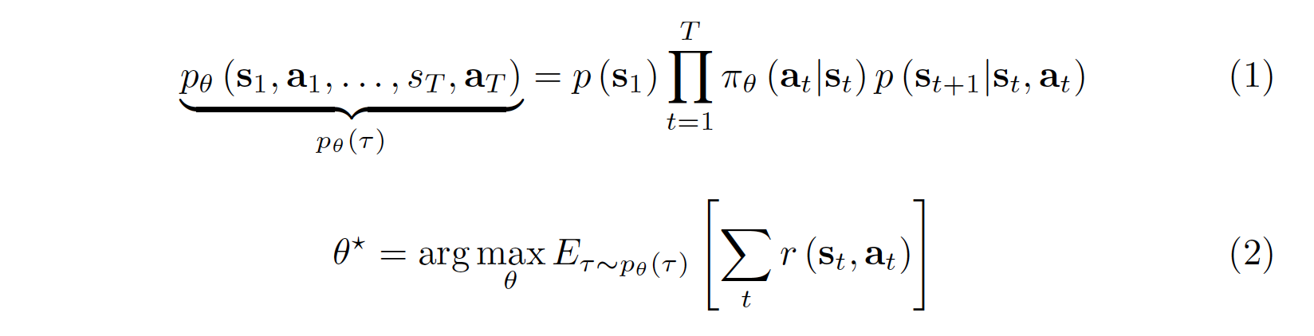
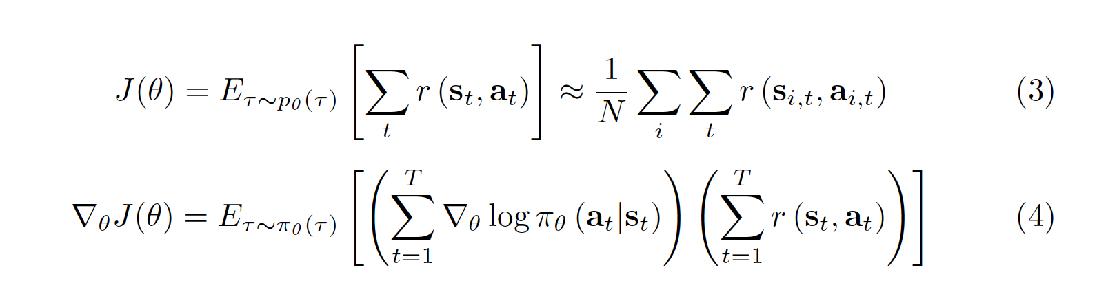

Project Ideas – Training Steps
The purpose is to maximize the reward in given trajectory:
Here we want to optimize the learned parameters maximize the expected survival rewards by adopting policy gradient method:
We will update based on epoch:

Slide 9
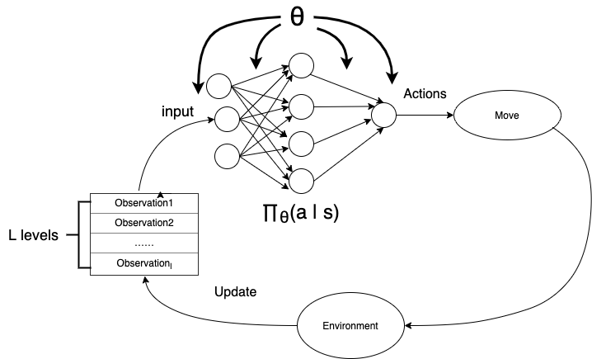
Project Ideas-Training Model
Training policy:
used embedding and flatten a agents’ reward to a one-dimensional encoded vector and fit it into a linear layer of with trainable parameters.
Training Model

Slide 10
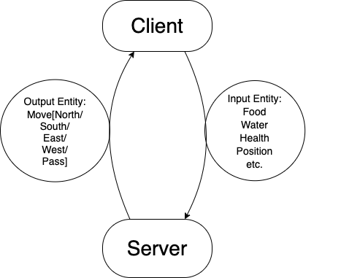
Project Ideas-Network Architecture
used Twisted Network Library to communicate packet information between client and server
Network Architecture

Slide 11
Current Progress
1. Determine the goal and rules for the game
2. Tried several failed approaches e.g. MLTS，turn-based ML-Agent
3. Chose DRL based on current STOA work and ideas
4. Figured out the basic NN architecture
(workflow from observation trajectory to the best action)
5. Defined communication-media pattern between client & server
6. Deployed machine Learning backend in local environment with support to AsyncIO
7. Deployed conducted basic training workflow

Slide 12
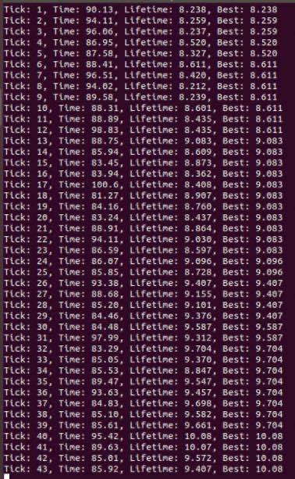
Current Progress
8. Persistent model to .h5 file and developed logging system during training runtime.
9. Explored current 2019 – 2020 works for similar environment agents such as listing LSTM for NN
implementation.
10. Explored distributed RL environment such as UCB Ray library , Spark and Hadoop.

Slide 13
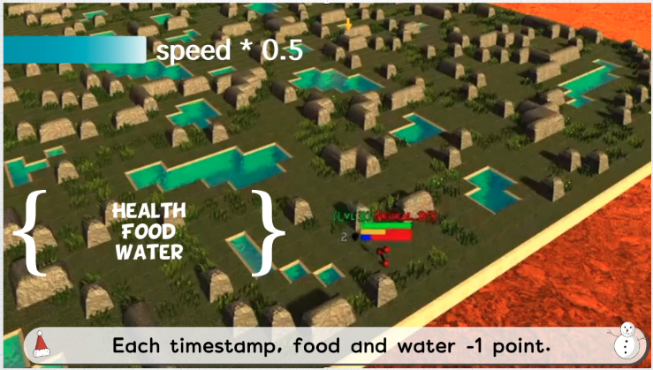
Demo

Slide 14
To do list:
1. Visualization in tensorboard for training.
2. Develop and train LSTM-based architected NN agent.
3. Try to use Ray for distributed training on several clusters which may support 100k agent (openAI realized 100M agents training in 100 core’s clusters)
4. Expand potential action for each agent such as attack build. etc.
5. Transfer-learning or few-shot learning given an agent to let agents can fit new environment in a few steps.

Slide 15
Thank you !

